Slide 1
Projection and
Perspective Warping
All operations till now use only the top 2 rows ie 6 values, so with this we can make use of the 3rd row to like have a 3d effect.
CSCI 4150/6050: Computer Vision

Slide 2
Perpective Warping

Slide 3
Perpective Warping
You’ve already seen how to perform transformations on an image, but they all existed in 2D plane.
Perspective projection is from any 3D plane to any other 3D plane

Slide 4
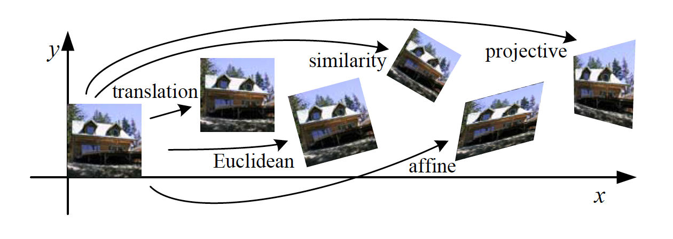
Classes of Transformations

Slide 5
“Straight On” View
Eg take 4 points from a scene and place them to look straight,

Slide 6
“Birds-Eye” View

Slide 7

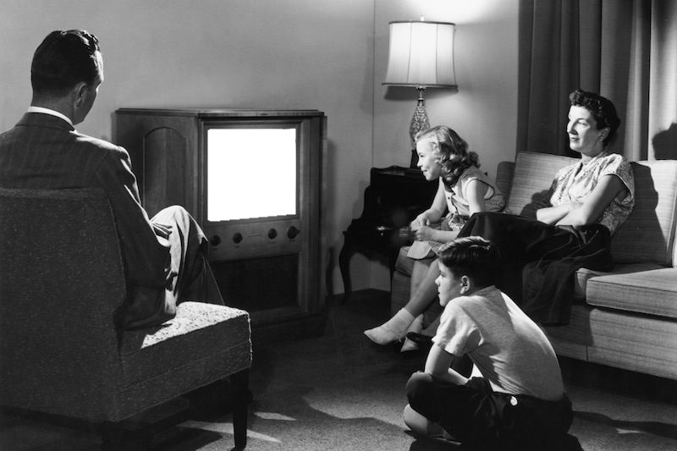

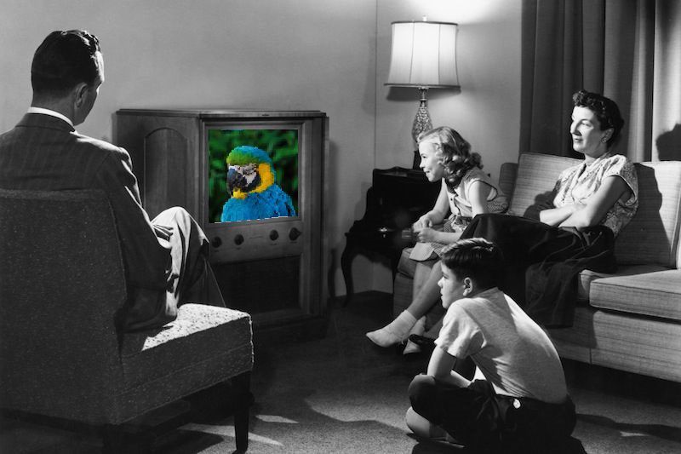
Or Going The Other Way

Slide 8
Let’s see it in Photoshop…

Slide 9
To understand perspective warping, we first need to understand how projection works.

Slide 10
Projection
Lowering the dimensions eg 3d to 2d is called
Projection.
To get 2D pictures of a 3D world, you have to use projection
  Orthographic
    Sometimes used in computer graphics
  Perspective
    How physical cameras capture images
Note that in this projection, the lines at the side of the castle are no longer parallel
Also things at the back appear smaller

Slide 11
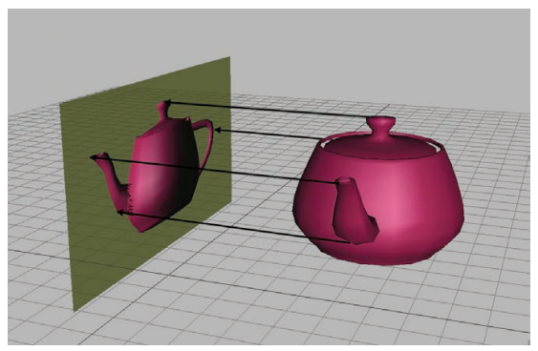
Orthographic Projection
Ie just x, y and z which is the distance, but this is not how our eyes work because we use angles.
Orthographic projection is just dropping a dimension.
Used in technical drawings, etc.

Slide 12
This is not how physical cameras work, so we won’t work with orthographic projection in this class.

Slide 13
Perspective Projection
We see things closer apperar bigger eg the curve bar, then as we go farther the bar looks smaller. Ie angle based geometry

Slide 14
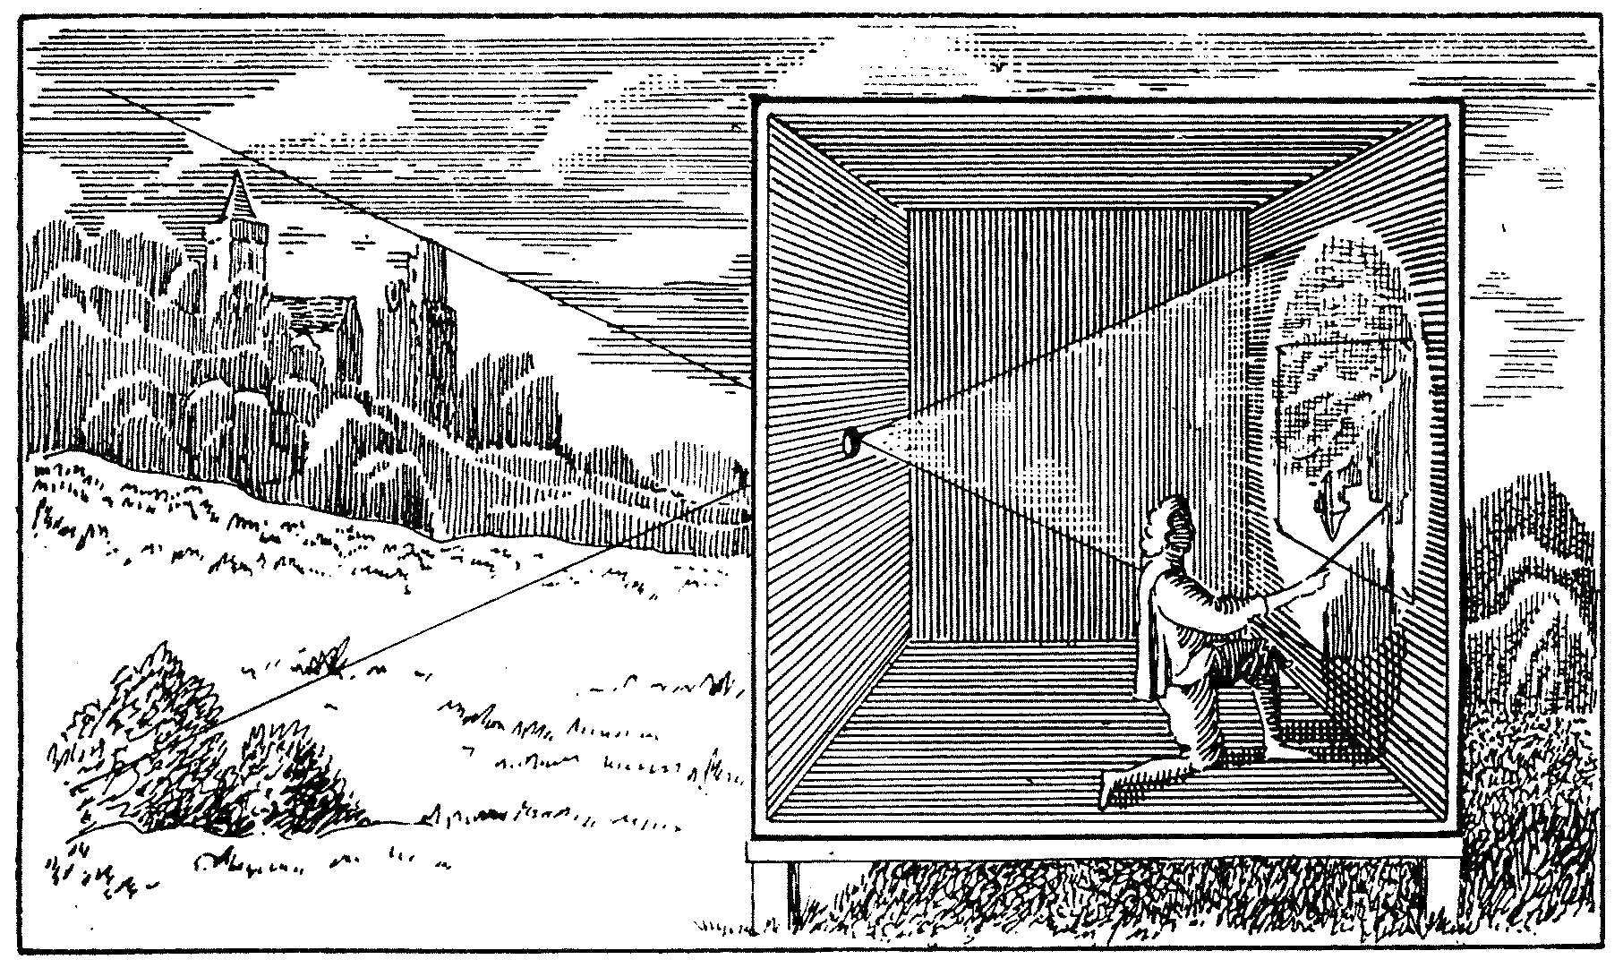
Camera Obscura
Image here appears inverted and upside down.

Slide 15
The Pinhole Camera
https://www.bhphotovideo.com/images/images500x500/Santa_Barbara_TEL9RO_4_x_5_Pinhole_151512.jpg
https://upload.wikimedia.org/wikipedia/commons/thumb/7/71/Camera_Oscura.jpg/220px-Camera_Oscura.jpg

Slide 16
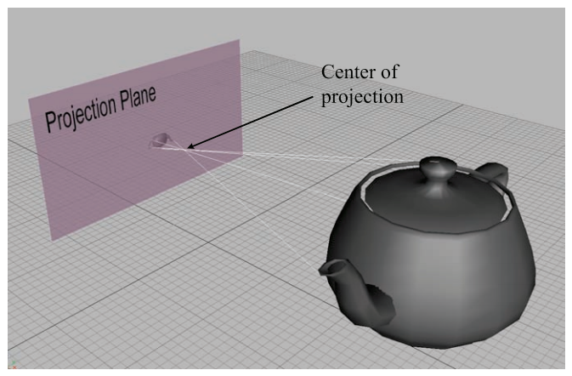
Perspective Projection
Pinhole camera model

Slide 17
Pinhole Cameras
focal point
optical axis
focal length
imaging
sensor
field of view

Slide 18
Geometric Model
focal point
optical axis
focal length
imaging
sensor
virtual
imaging
plane
field of view

Slide 19
Geometric Model
focal point
optical axis
focal length
virtual
imaging
plane
field of view

Slide 20



Camera Coordinates
focal
point
optical axis
virtual
imaging
plane
field of view

Slide 21
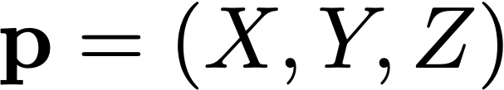
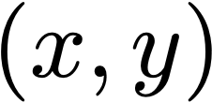
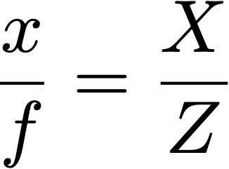
Projection
Ie if I know my camera settings ie at the focal point, and we have some point at p, we try to find (x,y) ie where that intersects on our imaging plane.
focal
point
optical axis
By similar triangles:
virtual
imaging
plane

Slide 22
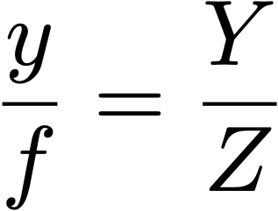
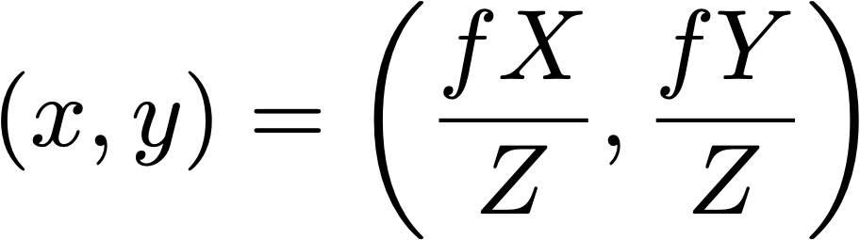
Projection
Note: this is the projected coordinate in real-world units.
To get actual pixel location, scale by pixel density
and apply offset to image origin (more on this later...)

Slide 23
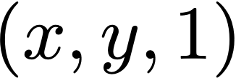
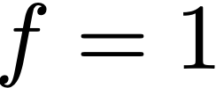
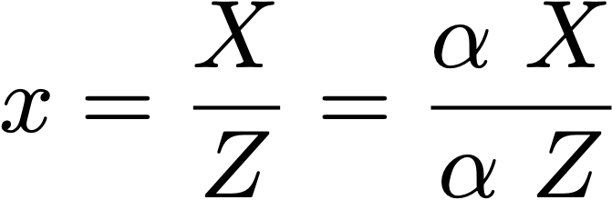
Projection
homogeneous coordinate!
focal
point
optical axis
By similar triangles:
virtual
imaging
plane

Slide 24
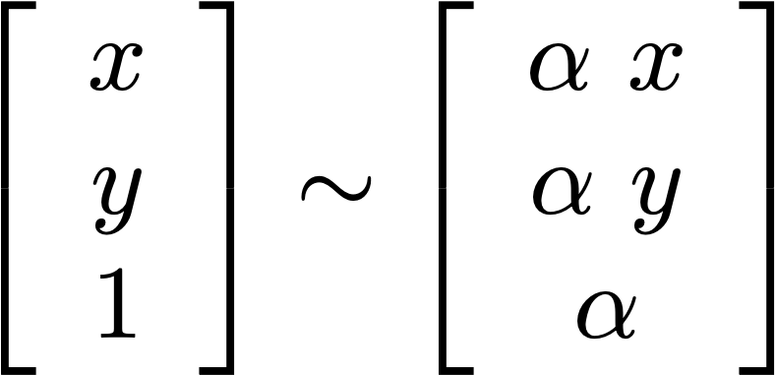
Key Idea: Homogenous Coordinates
Homogeneous coordinates are used to represent all 3D points along the ray that falls on the same 2D projection:
When you divide by the bottom value in this pseudo 3D coordinate, it represents the location the (x,y) location of the point on the image plane.

Slide 25

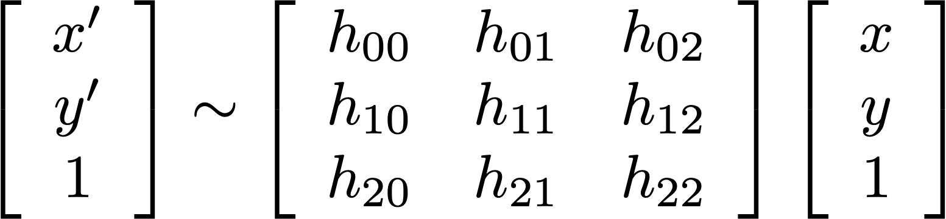
Homographies
Perspective projection from a plane to another plane is a homography
Same 3 x 3 matrix transformation you’ve seen before, but the bottom row doesn’t have to be [0 0 1]
In practice, it’s invertible!

Slide 26
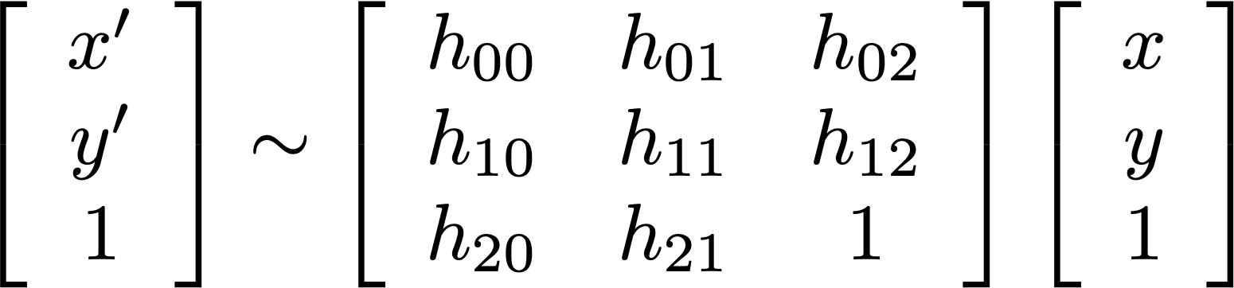
Homographies
Non-zero multiple of a homography does the same transformation
That means there are really only 8 free parameters, not 9

Slide 27
Multiple Pictures of the Same Plane
If two cameras take pictures of a plane from different viewpoints,
  The projection of the plane to each camera is a homography
  The transformation of points from one picture to the other is also a homography!

Slide 28
Computing Homographies
At least 4 points or known pairs between the two images, ie x and y for each to compute these 8 unknowns.
Eight free parameters
A pair of matching points provides two constraints (one for x, one for y)
Four points provides eight equations to solve for eight unknowns
Called the 4-point algorithm

Slide 29

Computing Homographies
Can compute analytically if you know
  Relative positions of cameras (T)
  Relative orientations of cameras (R)
  Camera parameters (K)
  Orientation of the observed plane
  (its surface normal n)
  Distance to the observed plane (d)
Problem: you may not know all these
What if you just have the two images?

Slide 30
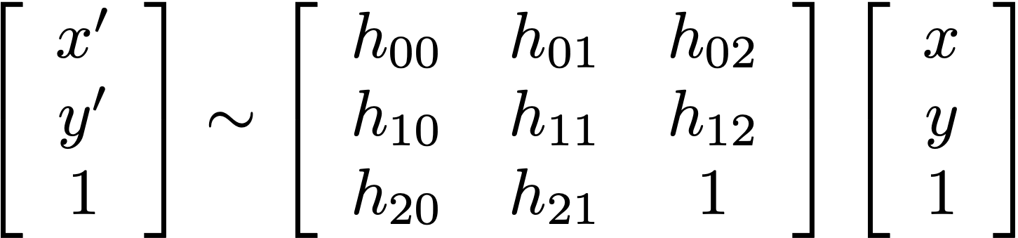

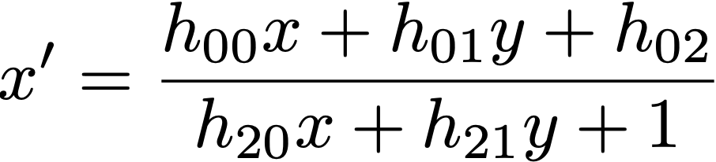
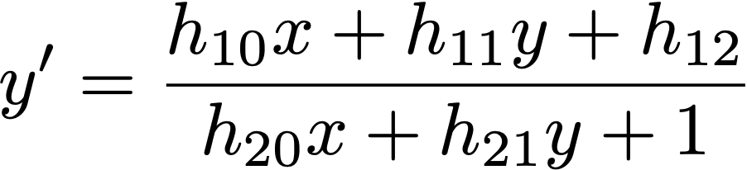
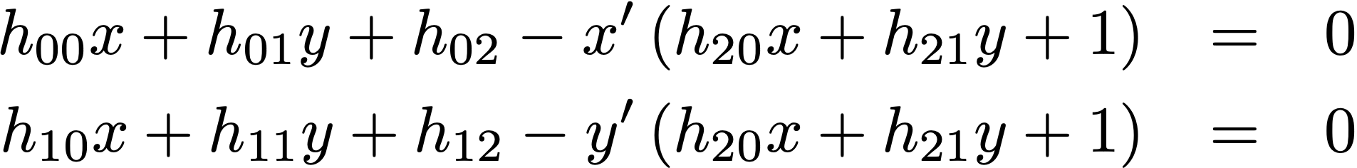
Computing Homographies
Dividing here by the homogenous devide we get a set of two equations from every pair of points.

Slide 31
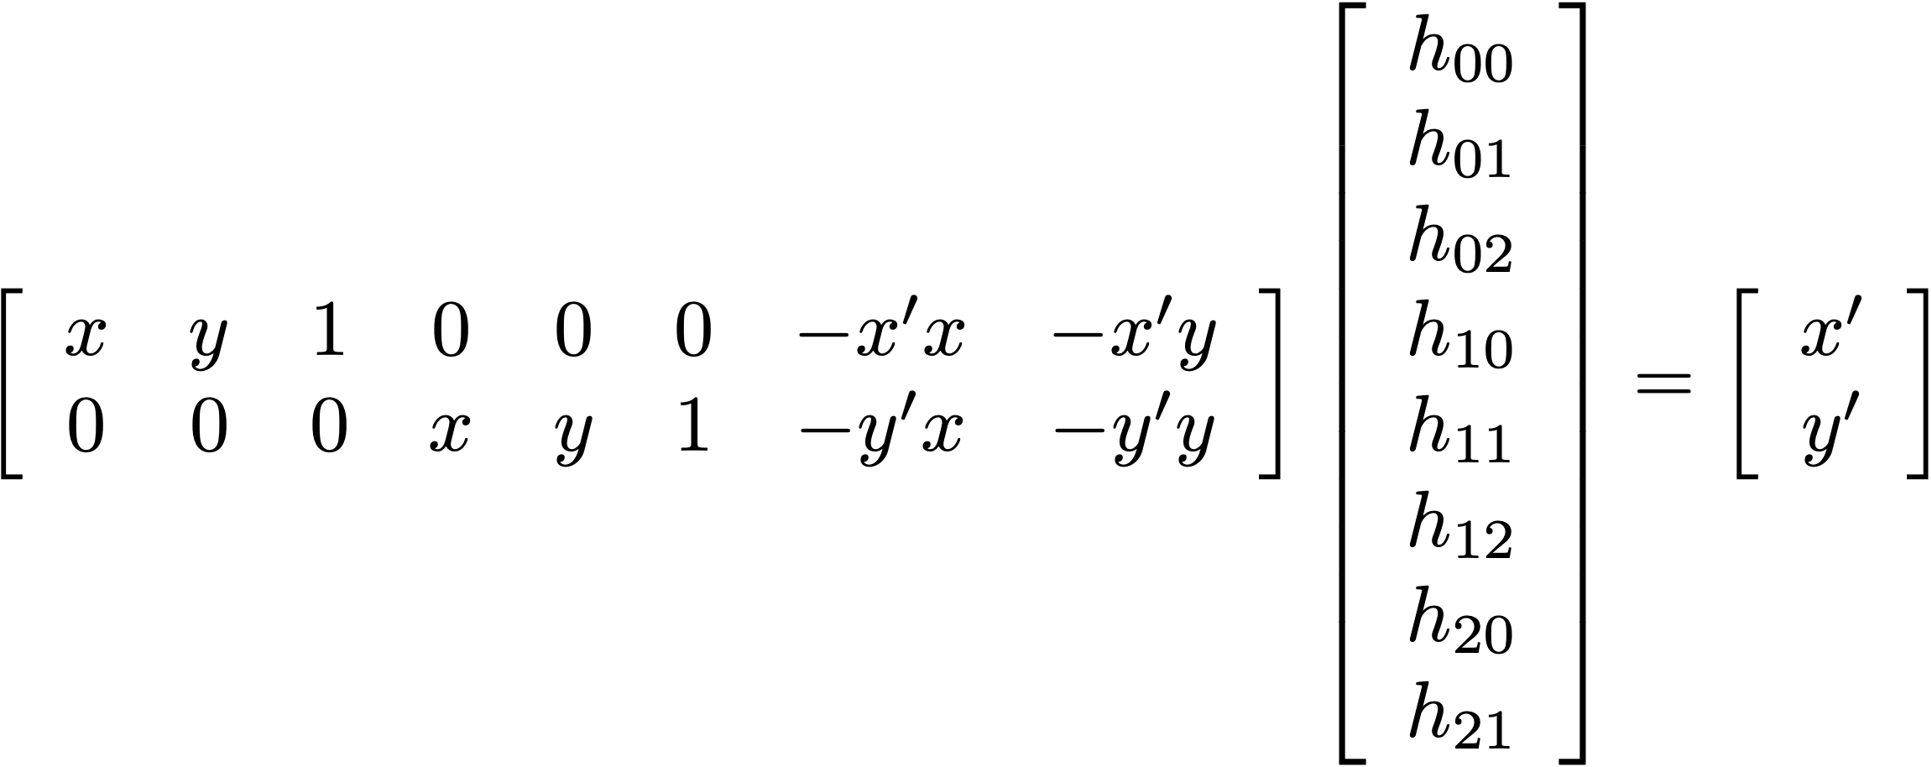
Computing Homographies
The above 2 equations equals the bottom matrix multiply equation. Use this for this set of points
And just append 6 other rows for the 3 remaining set of points giving an 8x8 matrix.

Slide 32
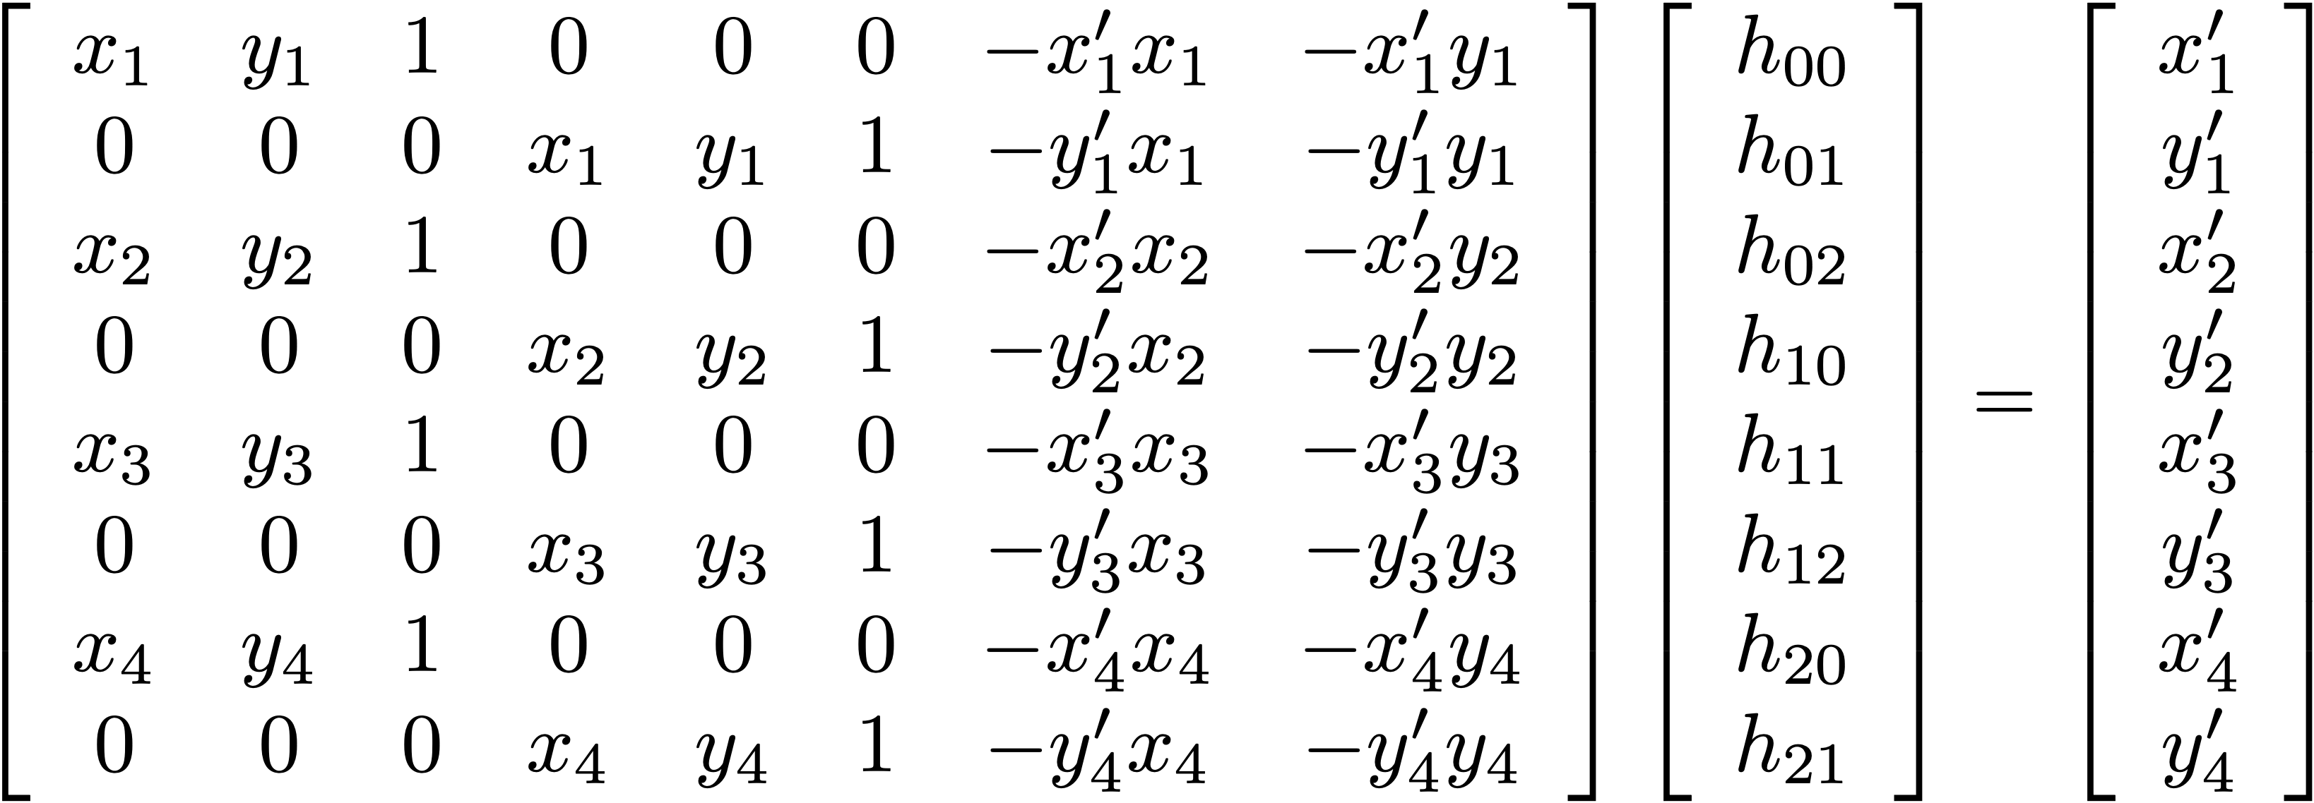
The Four-Point Algorithm

Slide 33
The Four-Point Algorithm
$A$
$x$
$b$
Solving for x here is: x – A-1*b, ie A inverse * b
Don’t worry, this is all implemented for you!

Slide 34
Let’s see it in NumPy…

Slide 35
Aside: N-Point Algorithms
Computer vision often requires calibrating parameters between multiple cameras, images, etc.
These calibrations can have many unknowns, and you need the same number of points as there are unknowns.
The four-point algorithm can be expanded to any number of points.
Example: Calibrating two cameras with 5 unknowns each will require 5 known points in each image.

Slide 36
Caution: Avoid Co-Linear Points
Solution fails if any 3 of the 4 points are co-linear
(the matrix in the 4-point algorithm becomes singular)
Don’t even get close to co-linear!
(badly conditioned)
Good:
Bad:

Slide 37
The Homogenous Divide
What does this symbol mean?

Slide 38
The Homogenous Divide
Multiplying by a full 3 x 3 transformation matrix no longer guarantees a that 1 will remain in the homogenous coordinate.
In other words, a homography transformation will give us a 3D point that is usually not on the image plane.
To solve this, reproject the point back to the image plane by dividing by the homogenous value.

Slide 39
The Homogenous Divide
=
$\left[\begin{matrix}x′ \\ y′ \\ 1\end{matrix}\right]=\left[\begin{matrix}{x_{h}}/w \\ {y_{h}}/w \\ w/w\end{matrix}\right]$
=
Homogenous Divide

Slide 40

Lab 4
We are provided the 4 points and the decoder, we have to
Align the 4 points and image pixels to fit into an
Array.
The qr code has the 4 squares used for the
4 point algorithm.

Slide 41
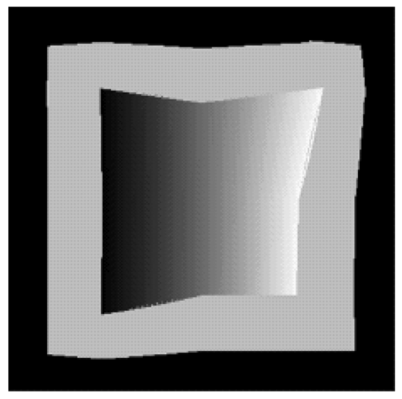
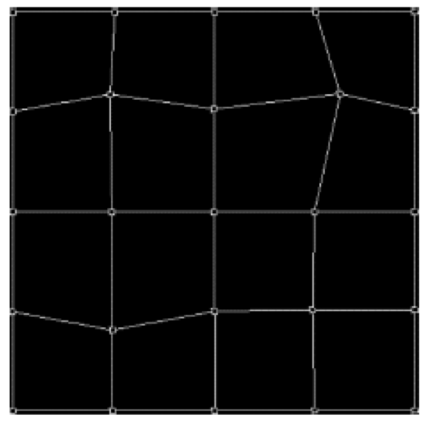
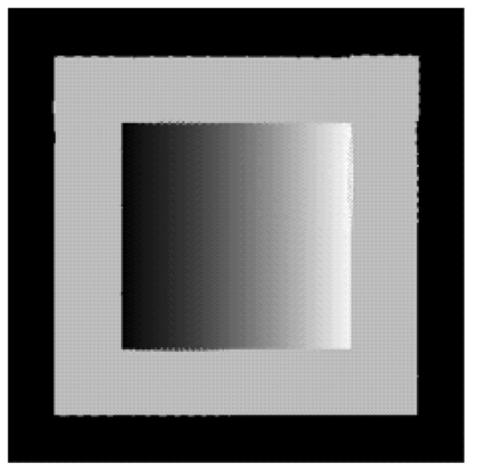
Generalizing Perspective Warp
In practice, this same process is not limited to a single plane, but can applied to piecewise across the image.
This is sometimes called mesh warp.
Distorted
source
Overlaying
source mesh
Restored
result

Slide 42
Let’s see it in Photoshop…

Slide 43

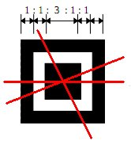
QR Codes: Finding Corners

Slide 44
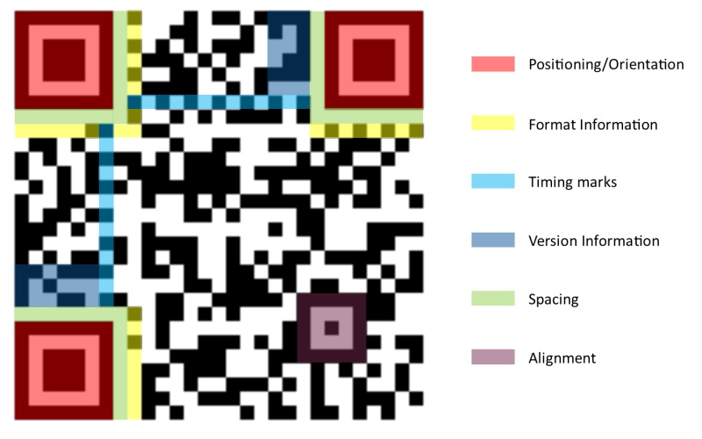
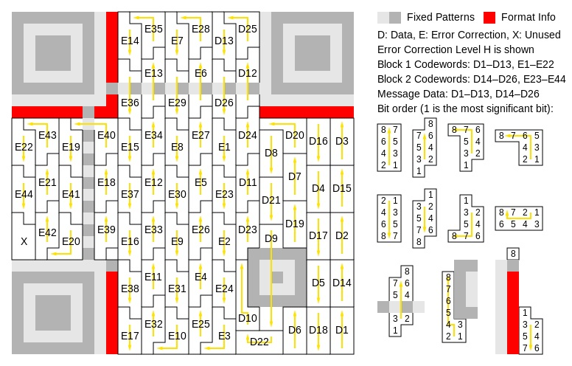
QR Codes: Reading Data
http://datagenetics.com/blog/november12013/index.html

Slide 45
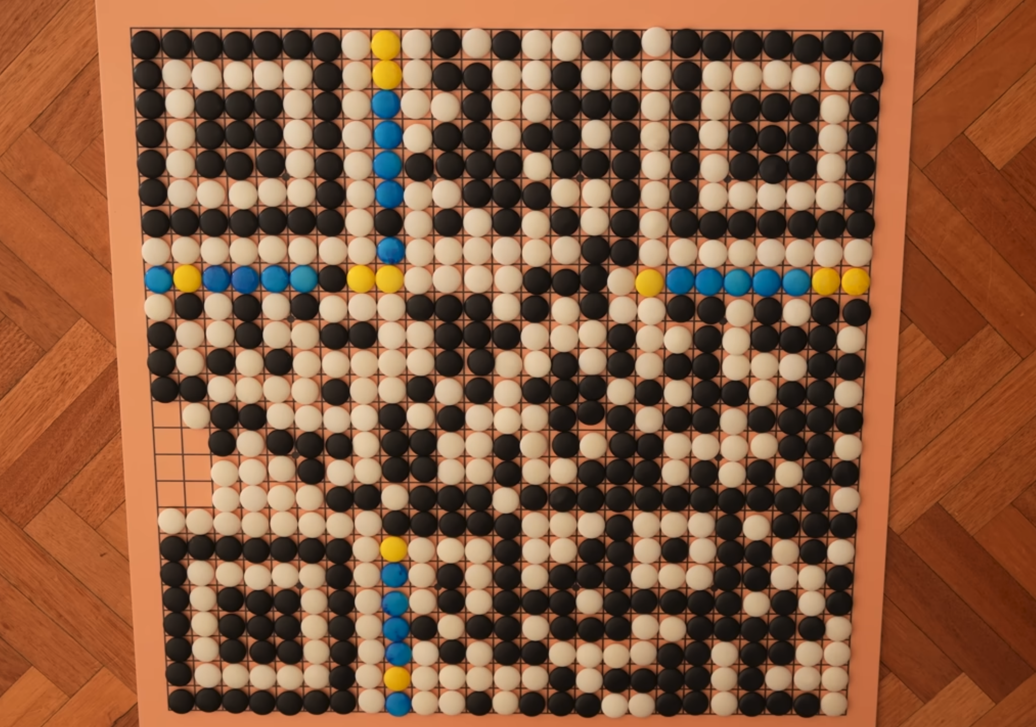
QR Codes: Veratasium
Watch video
https://www.youtube.com/watch?v=w5ebcowAJD8

